Slide 1
Convolutional Neural Networks
Used for:
object recognition,
including image classification,
detection, and segmentation.
Additionally, it is utilized in natural language processing, time series analysis, and speech recognition.
Convolution Layer in a CNN
The convolution layer is the core building block of a Convolutional Neural Network (CNN). It is responsible for extracting features from input data (e.g., images) by applying convolution operations. These layers help the model learn local patterns, such as edges, corners, and textures, which form the foundation for understanding more complex features. Summing up we can say that The main objective of Convolutional Layers is FEATURE EXTRACTION.
Convolution layer is responsible for detecting patterns at different levels of complexity. Its efficiency, flexibility, and ability to extract hierarchical features make it indispensable in deep learning tasks.
Pooling Layer :
Main objective is indeed dimensionality reduction
It convert a large image to smaller and preserve all the important features like edges and colors.
The pooling layer operates independently on every depth slice of the input.
Using the Max or Average of the values in a window slid over the input data.

Slide 2
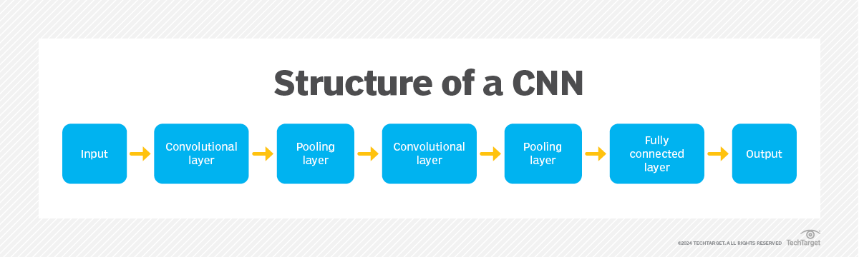
Architecture of a CNN

Slide 3
Convolutional layer
This layer uses a filter or kernel -- a small matrix of weights -- to move across the receptive field of an input image to detect the presence of specific features.
The process begins by sliding the kernel over the image's width and height, eventually sweeping across the entire image over multiple iterations

Slide 4
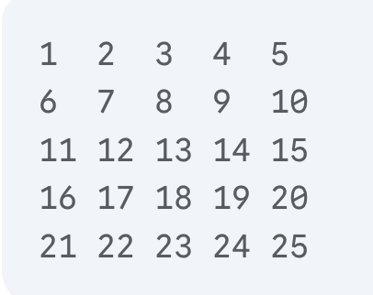
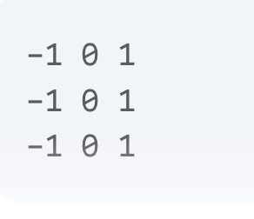
Convolutional layer Operations
Let's say we have a 5x5 input image X
And a 3x3 filter W:

Slide 5
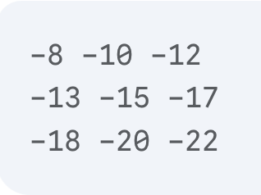
Convolutional layer Operations
With stride s = 1 and padding p = 0, the output feature map Z would be 3x3

Slide 6
Convolutional layer Operations

Slide 7

Problem in Convolutional Operations

Slide 8
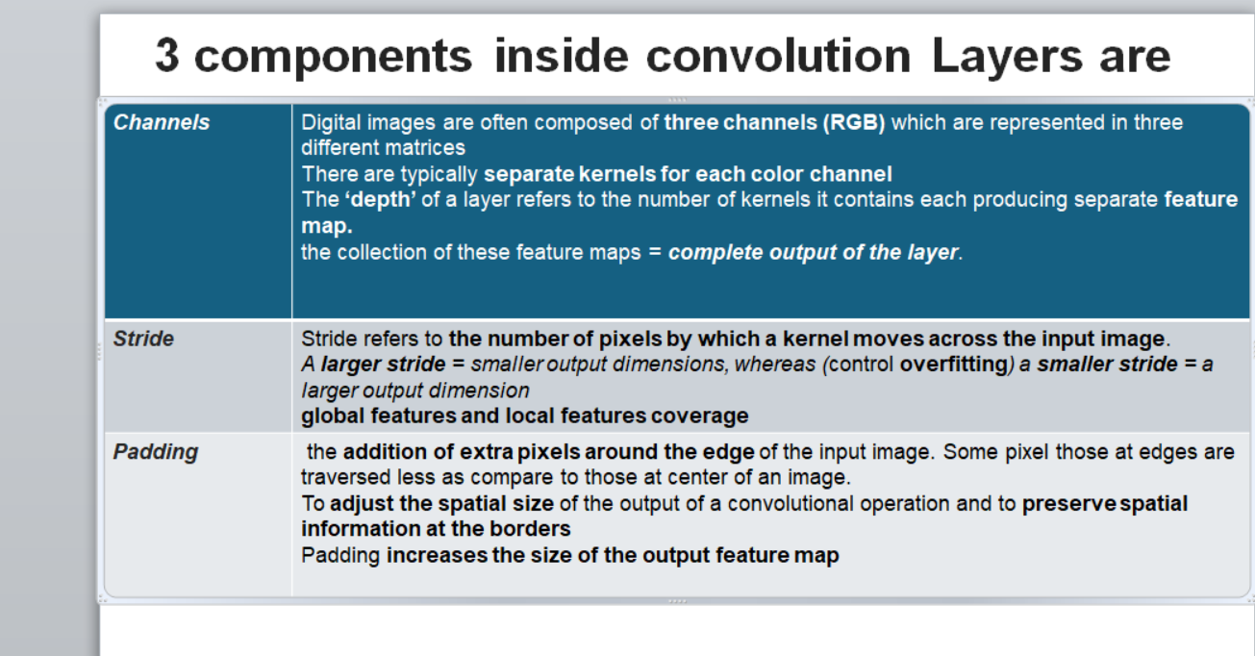
Padding
Without padding, the output feature map of a convolutional layer will be smaller than the input image
Padding adds extra pixels (usually with value 0) around the borders of the input image

Slide 9
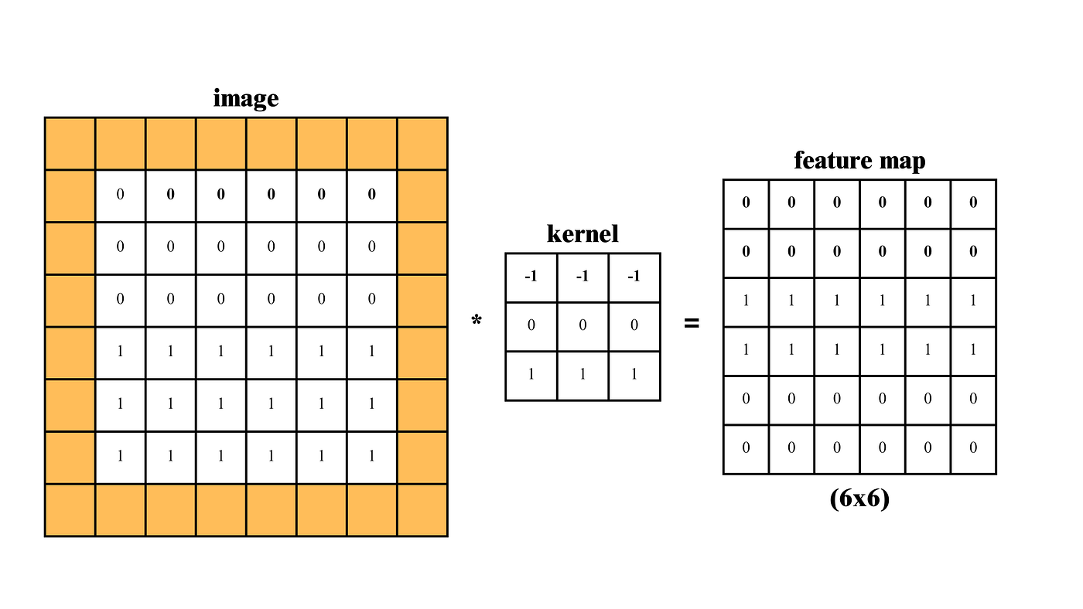

Slide 10
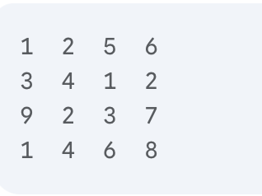
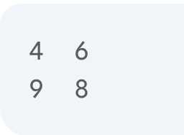
Max pooling
Max pooling is a down sampling operation that reduces the size of the feature maps generated by convolutional layers
Let's say we have a 4x4 feature map
With a 2x2 pooling window and a stride of 2, the max pooling operation would produce the following 2x2 output

Slide 11
Why Max Pooling
Dimensionality Reduction
Spatial Invariance
Feature Emphasis

Slide 12
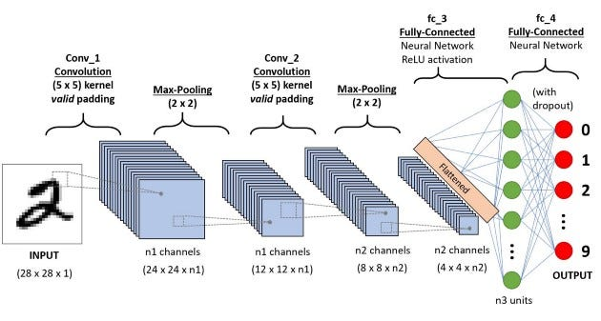
Fully Connected Layer
https://vijay-choubey.medium.com/understanding-convulutional-neural-networks-9b0cbd9b3055

